Slide 1
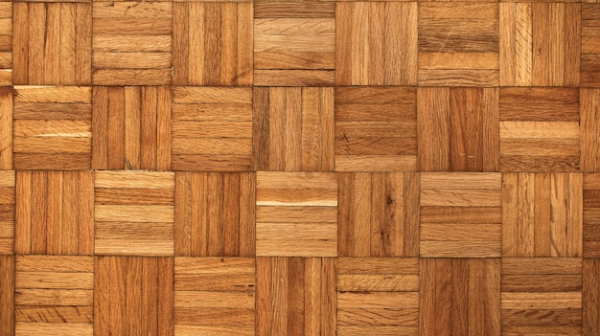
Should you use Geo-parquet?
and why (not)….
Tom van Tilburg, foss4g BE/NL 2024

Slide 2
Contents
What is geoparquet
Cloud optimized
Columnstorage
Vectordata
How does it work
In the wild (overture)
Our first steps with parquet (sensordata)
Advantages / disadvantages
Now let's try geo-parquet
Create with OGR2OGR, upload to cloud
Throw URL in QGIS
Are there alternatives?
benchmark(from leda) / have slides at hand
Should I use geoparquet?
It depends.....
Further reading

Slide 3
Before we begin
Who knows geoparquet?
Who has worked with geoparquet?​
​
​
Anyone publishing data in geoparquet?​​
​​
​​
Who knows how to pronounce it correctly?
Notes:
Who knows geoparquet?
Who has worked with geoparquet?
Anyone publishing data in geoparquet?
Who knows how to pronounce it correctly?

Slide 4
Our first steps with Parquet @
1.5 TB of road data, postgis doesn't scale well
We needed to do analytics
Parquet was cheap to host
Duckdb upcoming database system for analytics
All of our Sensordata is now hosted as parquetfiles

Slide 5
What is (geo)parquet?!
File format
Based on apache arrow format
Column based
Cloud optimized (header with block-range information)
Extra bbox info stored for geometries
"a modern alternative to CSV files" (with geo data)

Slide 6
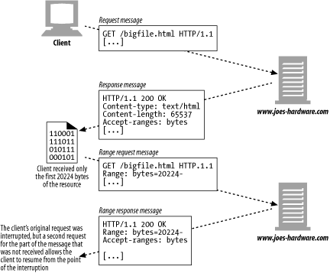
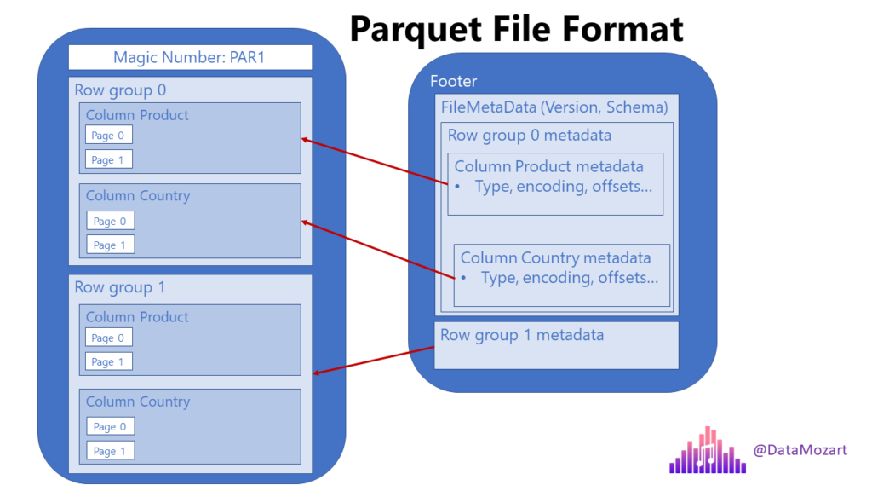
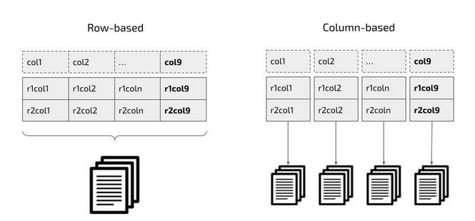
How does it work?
Column oriented
Metadata in header/footer
Range requests

Slide 7
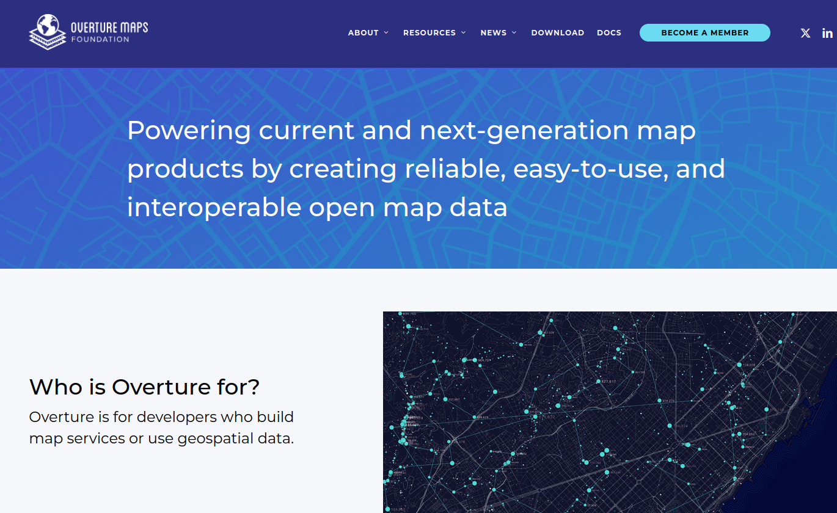
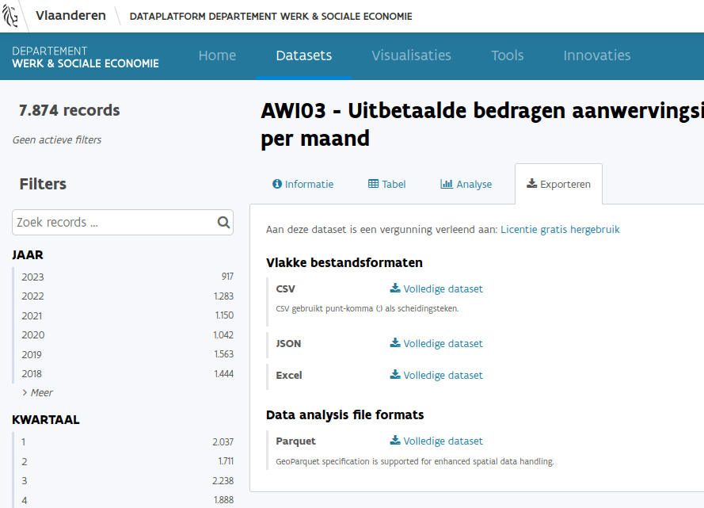
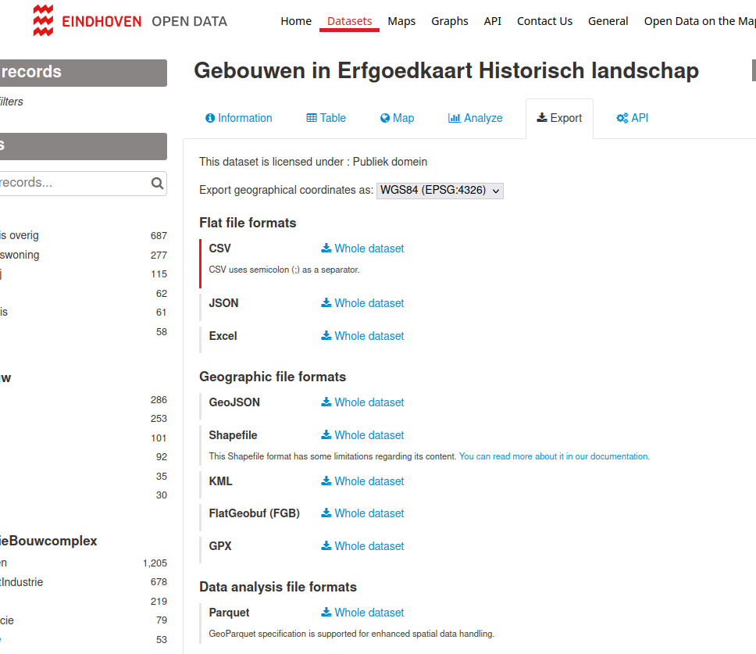
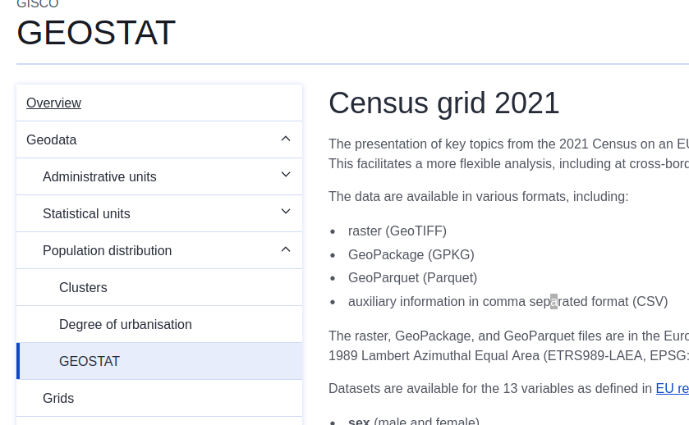
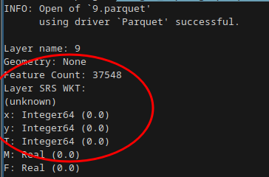
Geoparquet in the wild

Slide 8
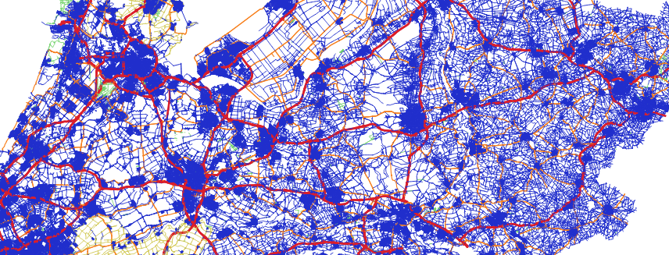
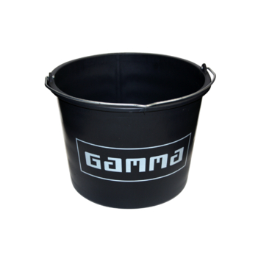
Lets create some parquet data
From 1.5 million road segments in the Netherlands
ogr2ogr wegvakken.parquet PG:"" \
-sql "SELECT * FROM nwb.wegvakken ORDER BY wkb_geometry"
Dump in a bucket

Slide 9
Do analysis in DuckDB
SELECT avg(ST_Area(geom)) as avg_area
FROM read_parquet('https://storage.googleapis.com/sogelink-research-public/projects/tomt/bag_pand.parquet')
WHERE ST_Intersects(geom, ST_MakeEnvelope(84656, 452996, 85272, 453380))
AND geom_bbox.xmin > 84656 AND geom_bbox.ymin > 452996
AND geom_bbox.xmax < 85272 AND geom_bbox.ymax < 453380;

Slide 10
Use it in QGIS?
Notes:
Carefull with your classification (all records will be checked)

Slide 11
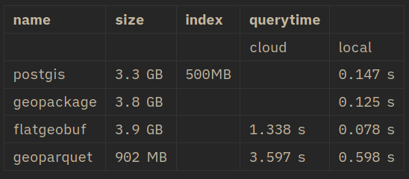
Performance benchmark
Benchmark data: bag.pand -> 11 mil. records of Dutch building footprints

Slide 12
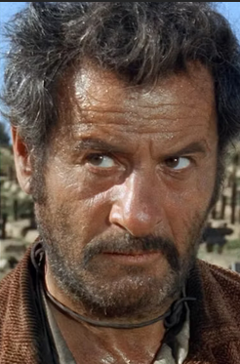
Good
Cheap
Cloud optimized
Simple
Small files
Fast for analysis
Standard
Bad
Hard to update data
No indexing
Not fastest for browsing
Ugly
Infancy issues for geo
Metadata is also big
Sort your data!

Slide 13
Should you use Geoparquet?
it depends!

Slide 14
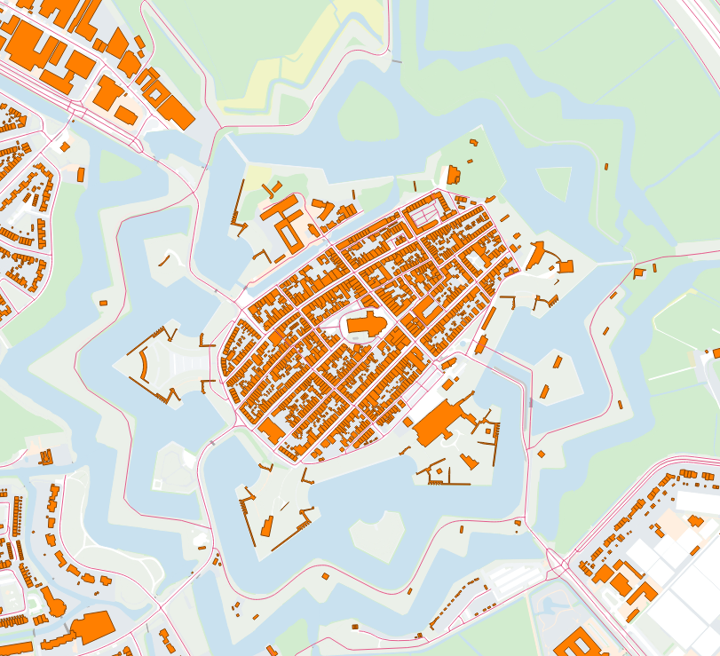
Geoparquet
Not when you
want to serve large datasets for
visualisation (use filegeodb)
Yes, when you
do data analysis! (duckdb, python etc.)
serve (very large) datasets in the cloud
(cheap and reliable)
have timeseries data
just want to transfer datasets

Slide 15
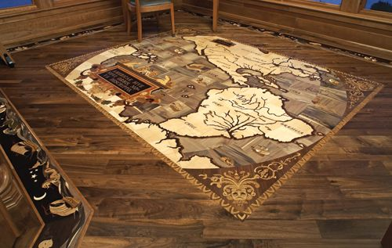
Happy mapping!

Slide 16
Background reading
Geoparquet Website Introduction to STAC GeoParquet blog, 29 August 2024 GeoParquet and GeoArrow in deck.gl | Kyle Barron | Cloud Engineer at Development Seed youtube, 12 Dec 2023 The GeoParquet Ecosystem at 1.0.0, blog, 4 Oct 2023 Spatial indexing in Geoparquet youtube, 28 May 2022 # Performance Explorations of GeoParquet (and DuckDB) blog, 14 August 2023 # The Top 11 Open GeoParquet Datasets: Making big geospatial data easy, blog, January 18, 2024 overture gis data, blog, 05 November 2023

