Slide 1
Introduction Alliander
Open-Source Vector Tiles
Agenda
Andrea van Milgen
Wouter van der Hulst
Product Owner
Developer
andrea.van.milgen@alliander.com
wouter.van.der.hulst@alliander.com
Alliander develops and operates a large part of the Dutch energy networks
Notes:
1 Alliander & Mapbox cloud Vector tiles with Attribute information
Thanks for joining
Andrea + Wouter
We work @ Alliander = Large Grid Operator Netherlands
Goal: Tell you a little bit more about Alliander (geo info) and share our experiences with the development of our Mapbox cloud Vector Tiles
Agenda:
Introduction Alliander (Andrea)
Open-Source Vector Tiles (Wouter) Use case and technical details VT’s

Slide 2
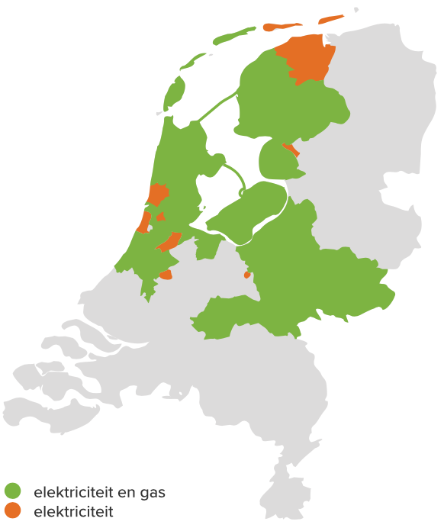
Part 1 Introduction Alliander
5.9 million connections (gas + electricity)
8,325 FTE Employees
FOSS4G Baarle 2024
Notes:
2 – Part 1 Introduction Alliander
Alliander develops and operates a large part of the dutch energy networks
Map of Alliander’s service area
Green = electricity & Gas grid
Orange = electricity only
5.9 million connections (gas + electricity)
More than 8000 employees

Slide 3
Digitalization
Optimizing Energy Systems through digitalization
Digitalization aims to drive and facilitate the digitalization of processes, products, services and applications.
Scaled Agile Framework
37 Agile Release Trains
180+ DevOps teams
Notes:
Digitalization (IT + Business)
Where IT and business work together.
Sense of scale: 180 dedicated DevOps teams that are organized into 37 Agile Release trains (SAFe)
ART = group of Scrum teams working on a shared goal, product or service
About half of Alliander employees are end users of our geoplatform
1500 FTE digitalization
Geo-information enables well informed spatial decision-making to effectively operate and optimize our energy distribution networks during the energy transition

Slide 4
Alliander GeoPlatform
Vision & mission
“We provide the self-regulating central geo-information hub with smart, efficient geo-tools, making us indispensable for the energy transition.”
Extensively automated platform management
Acceleration in the development of information products through the use of generic building blocs
A central geo-hub to find, access, create and share all available geo-information products
Notes:
4 - three years ago:
We are in the midst of the transition from building end user applications to providing a platform and tools, building blocks for development teams, in order to speed up the development of information products (to speed up the energy transition)
Vision
We provide the self-regulating central geo-information hub with smart, efficient geo-tools, making us indispensable for the energy transition. How do we want to achieve that?
Extensively Automated: Freeing up hands, so we can focus on delivering more value.
Building blocks: Scaling up (acceleration) → from classic IT to a platform where everyone can develop product (Asset VT’s)
Central Hub: Platform → find + create + share

Slide 5
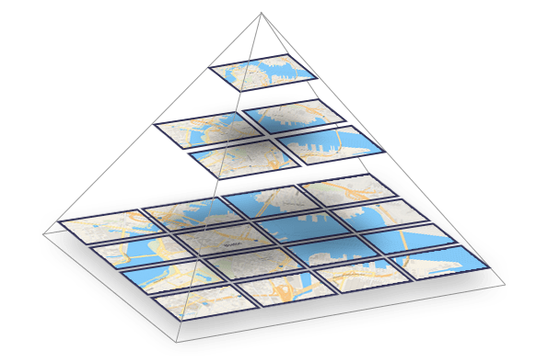
Deel 2 Open-Source Vector Tiles
FOSS4G Baarle 2024

Slide 6
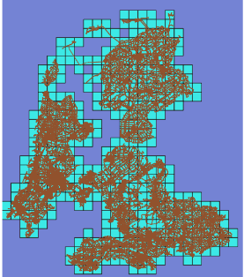
Use case
Open-Source Vector Tiles Alliander
Alliander Open-Source Strategy
Replace Esri Vector Tiles
Platform engineering
Customization vs. Blackbox
High Performance
Attribute Information in the Tiles
Generic Client Usability
Level z | Totaal RD | Totaal Alliander
0 | 1 | 1
1 | 4 | 4
2 | 4 | 4
3 | 6 | 6
4 | 16 | 14
5 | 56 | 42
6 | 1210 | 129
7 | 754 | 410
8 | 2900 | 1372
9 | 11.400 | 4812
10 | 45.372 | 16.451
11 | 181.488 | 49.777
12 | 724.245 | 143.977

Slide 7
Vector Tiles
Explained
Efficient Data Delivery
Scalability and Performance
Interactivity and Customization
Notes:
Efficient Data Delivery: Vector tiles are designed to deliver map data efficiently by breaking down the map into smaller, manageable tiles. Each tile contains vector data for a specific geographic area, allowing for quick and efficient data transfer and rendering.
Scalability and Performance: Vector tiles support scalable and high-performance map rendering. They allow for dynamic styling and rendering on the client side, which can adapt to different zoom levels and resolutions without the need to download new data.
Interactivity and Customization: Vector tiles enable rich interactivity and customization of maps. Since the data is in vector format, it can be easily styled, filtered, and manipulated on the client side, providing a highly customizable and interactive user experience

Slide 8
Components
Technical view
{..}
Postgres SQL
Postgis Enabled
Assets
Tile Index (RD New)
VectorTile Configuration
Zoomlevels
Layers
Attributes
Tile API
Styles & Sprites
VectorTileServer
Client
Rendering / Styling
On Click Attribute Info
ST_TileEnvelope()
JSON {…}
ST_AsMvt()
…/:tileset/:z/:x/:y.pbf
JS
Notes:
RD Base Tile Index Matrix
Calculate Tile Envelopes for Alliander
Config:
min / max lvl
Layers (160)
Primary attributes
Secondary attributes
Tile API:
- Simple x/y/z endpoint to fetch .pbf from s3 and deliver to the client
Custom endpoints for VetorTileServer Esri compatibility styles / resources and root.json’s
Client:
Styling
Custom Layerlist enable/disable layers
On Click attribute info

Slide 9
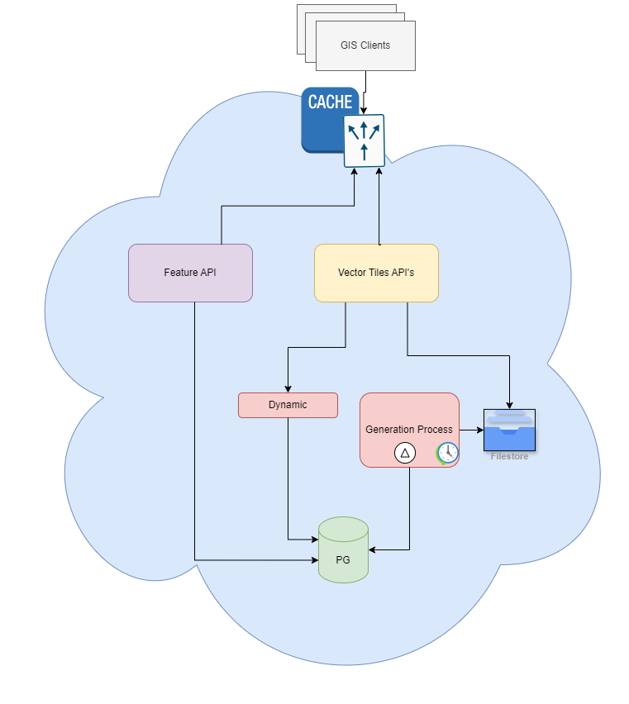
Components
Architecture
Notes:
Dynamic / Static or pregenerated with storage
Scheduled generation
Delta’s are possible
When Dynamic:
Smal less used sets users/areas. Higher refresh frequency
When Pre-generated:
General Purpose, lots of users, diverse areas
High Available High Performance requirements – Daily or less refreshes
And / Or with caching

Slide 10
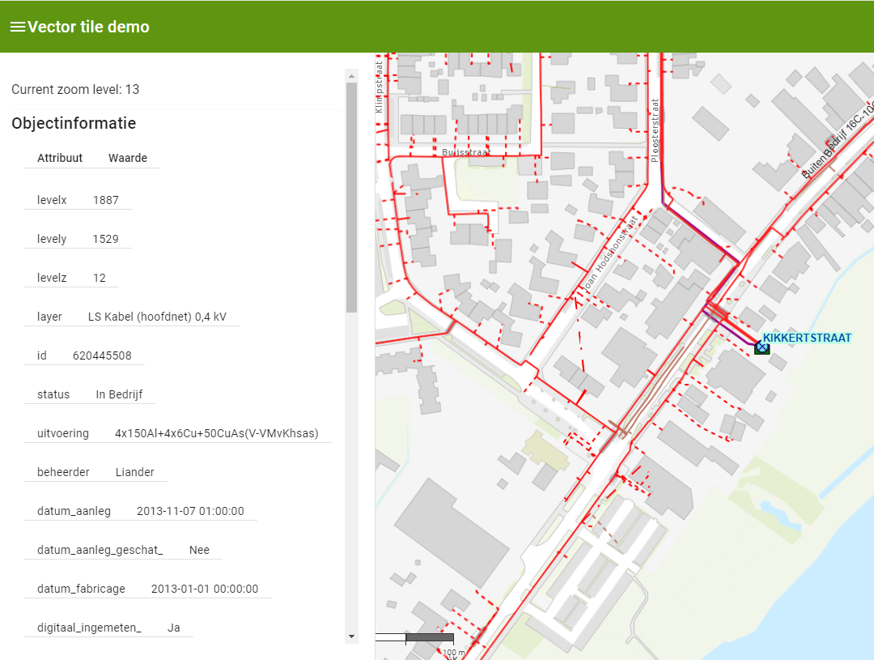
Demo
Electricity
Notes:
Dynamic / Static or pregenerated with storage
Scheduled generation
Delta’s are possible
When Dynamic:
Smal less used sets users/areas. Higher refresh frequency
When Pre-generated:
General Purpose, lots of users, diverse areas
High Available High Performance requirements – Daily or less refreshes
And / Or with caching

Slide 11
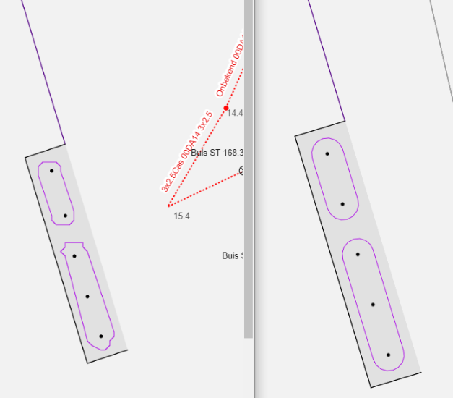
Achievements
Retrospective
Irregular lines. Hard corners
Increased pixel size within tiles
Overzooming in Esri maps js viewers
Esri requires a Tilemap
Generate a subset of the tiles
Attribute information available
Very Fast
Cloud Optimized Single File
Offline usability potential
Notes:
240.000 tiles
Basis Assets compleet m et primaire attributen
4.1Gb
Basis Assets compleet met alle attributen
10.8 GB
Basis Assets Elektra compleet met pirmaire attributen en detail attributen op het laagste niveau
8.4Gb

