Slide 1
Large-scale Geospatial computations?
Recycle your PostGIS spatial SQL queries with Apache Sedona
Benjamin Deswysen

Slide 2
Benjamin Deswysen
→ Geomatician @GeoPostcodes
Polleur (Liège, Belgium)
ULiege, UNamur
Geo data science & engineering
OSM occasional contributor
© Taïs Grippa - 2023

Slide 3
Large-scale geospatial computations
01
03
02
04
Recycle your PostGIS spatial SQL queries with Apache Sedona
GeoPostcodes
Apache Sedona
Postgis
Coexisting solutions

Slide 4
01
GeoPostcodes
In a nutshell

Slide 5
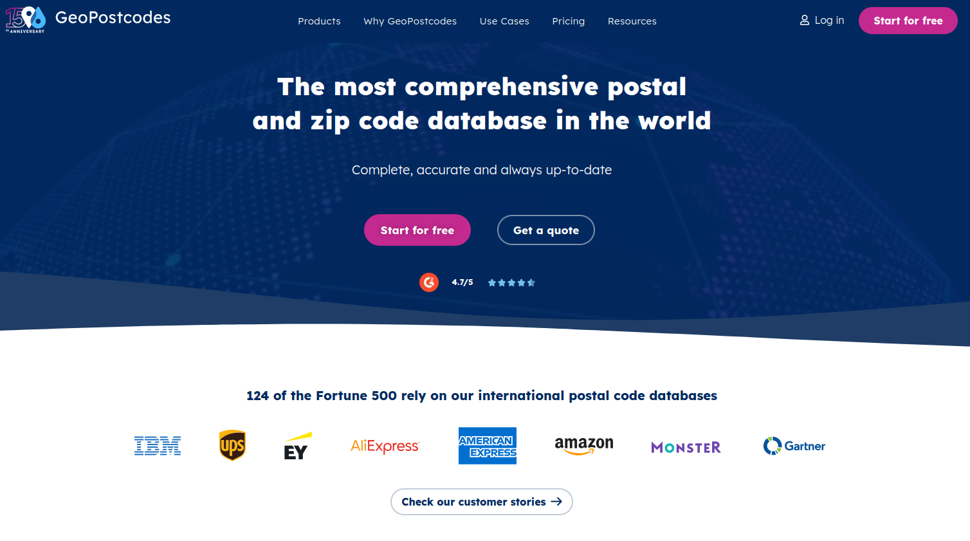

Slide 6
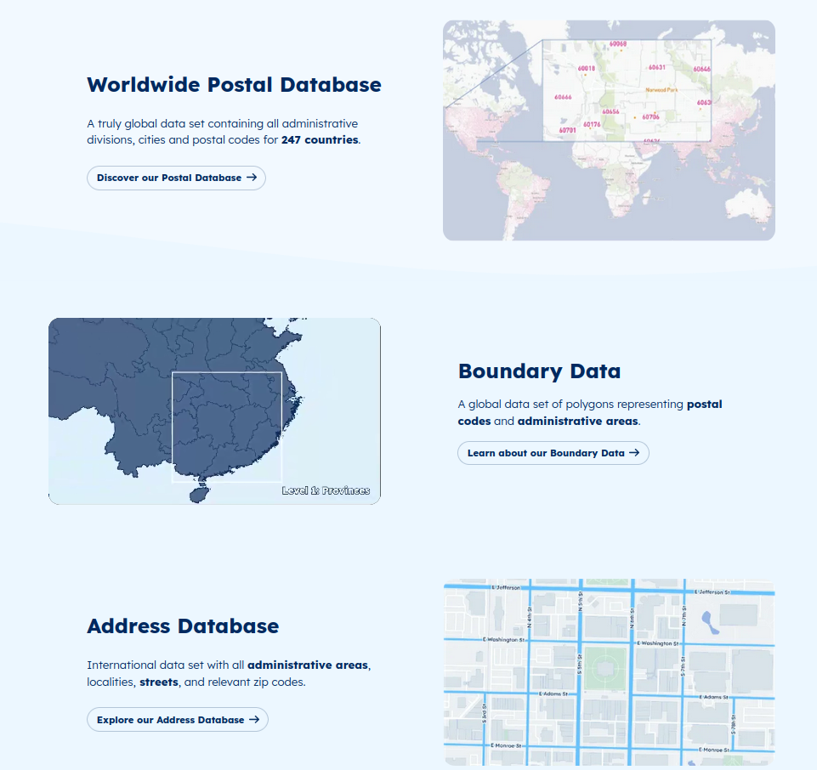

Slide 7
Postal database product
4 M
316 K
Cities
66 K
Admin. areas
8.6 M
Rows updated per week
Postcodes

Slide 8
Technological stack
Text

Slide 9
02
Postgis
Spatial SQL

Slide 10
Spatial SQL in Postgis
Standard SQL
Efficient indexing
Support complex geometries + coord. Systems
Support geoprocessing and geospatial operations
Combining storage and analytics
Custom functions in pl/pgsql
Handling large datasets + scalability
Handling very large datasets + scalability
Notes:
Example of geoprocessings and geospatial operations: repeated spatial joins, intersections, or proximity calculations

Slide 11
Scalability in Postgis
Handling parallel processing
Efficient transaction management to take advantage of indexes
Limit impact on other users
→ By default, Postgresql is ideal for OLTP but is not a distributed data processing engine designed for large-scale data analytics
Notes:
Example of geoprocessings and geospatial operations: repeated spatial joins, intersections, or proximity calculations, Voronoi tesselations generation, KNN analysis, ….

Slide 12
03
Apache Sedona
Spatial SQL

Slide 13
What is Apache Sedona?
= cluster computing system for processing large-scale spatial data.
→ Sedona extends existing cluster computing systems with a set of Spatial SQL tools
+ efficiently load, process, and analyze large-scale spatial data across machines
https://sedona.apache.org
Notes:
Example of geoprocessings and geospatial operations: repeated spatial joins, intersections, or proximity calculations, Voronoi tesselations generation, KNN analysis, ….

Slide 14
How to use Apache Sedona?
Sedona offers Scala, Java, Spatial SQL, Python, and R APIs and integrates them into underlying system kernels with care. You can simply create spatial analytics and data mining applications and run them in any cloud environments.
https://sedona.apache.org
Notes:
Example of geoprocessings and geospatial operations: repeated spatial joins, intersections, or proximity calculations, Voronoi tesselations generation, KNN analysis, ….

Slide 15
Spatial SQL in Apache Sedona
Standard SQL
Efficient (automatic!) indexing
Support complex geometries + coord. Systems
Support geoprocessing and geospatial operations
Custom functions in python/java/scala
Handling large datasets and heavy processings : easy horizontal scalability (cluster computing architecture)
Cloud native solution: not combining storage and analytics
Notes:
Example of geoprocessings and geospatial operations: repeated spatial joins, intersections, or proximity calculations

Slide 16
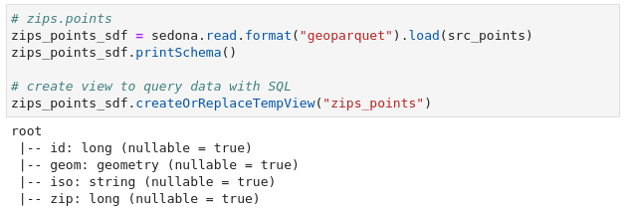
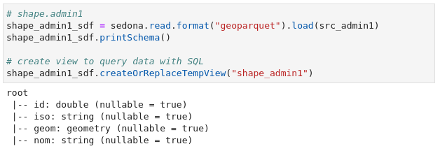
Example - read data
Dataset 1
Dataset 2
Notes:
Example of geoprocessings and geospatial operations: repeated spatial joins, intersections, or proximity calculations

Slide 17
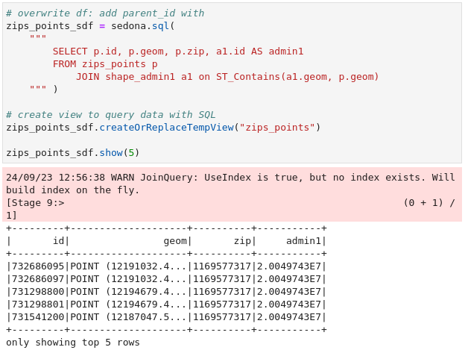
Example - SQL query
Spatial join
Notes:
Example of geoprocessings and geospatial operations: repeated spatial joins, intersections, or proximity calculations

Slide 18
04
Coexisting solutions
Getting PostGIS and Apache Sedona to work together

Slide 19
Postgis
Apache Sedona
Regular GIS infrastructure
Detailed transactions, operations requiring high precision and integrity
Persistence, long-term data storage
Cloud oriented infrastructure
Scalable data operations
Rapid processing of vast quantities of spatial data
Notes:
Example of geoprocessings and geospatial operations: repeated spatial joins, intersections, or proximity calculations

Slide 20
Notes:
Example of geoprocessings and geospatial operations: repeated spatial joins, intersections, or proximity calculations

Slide 21
Thank you for your attention!
Notes:
Example of geoprocessings and geospatial operations: repeated spatial joins, intersections, or proximity calculations

Slide 22
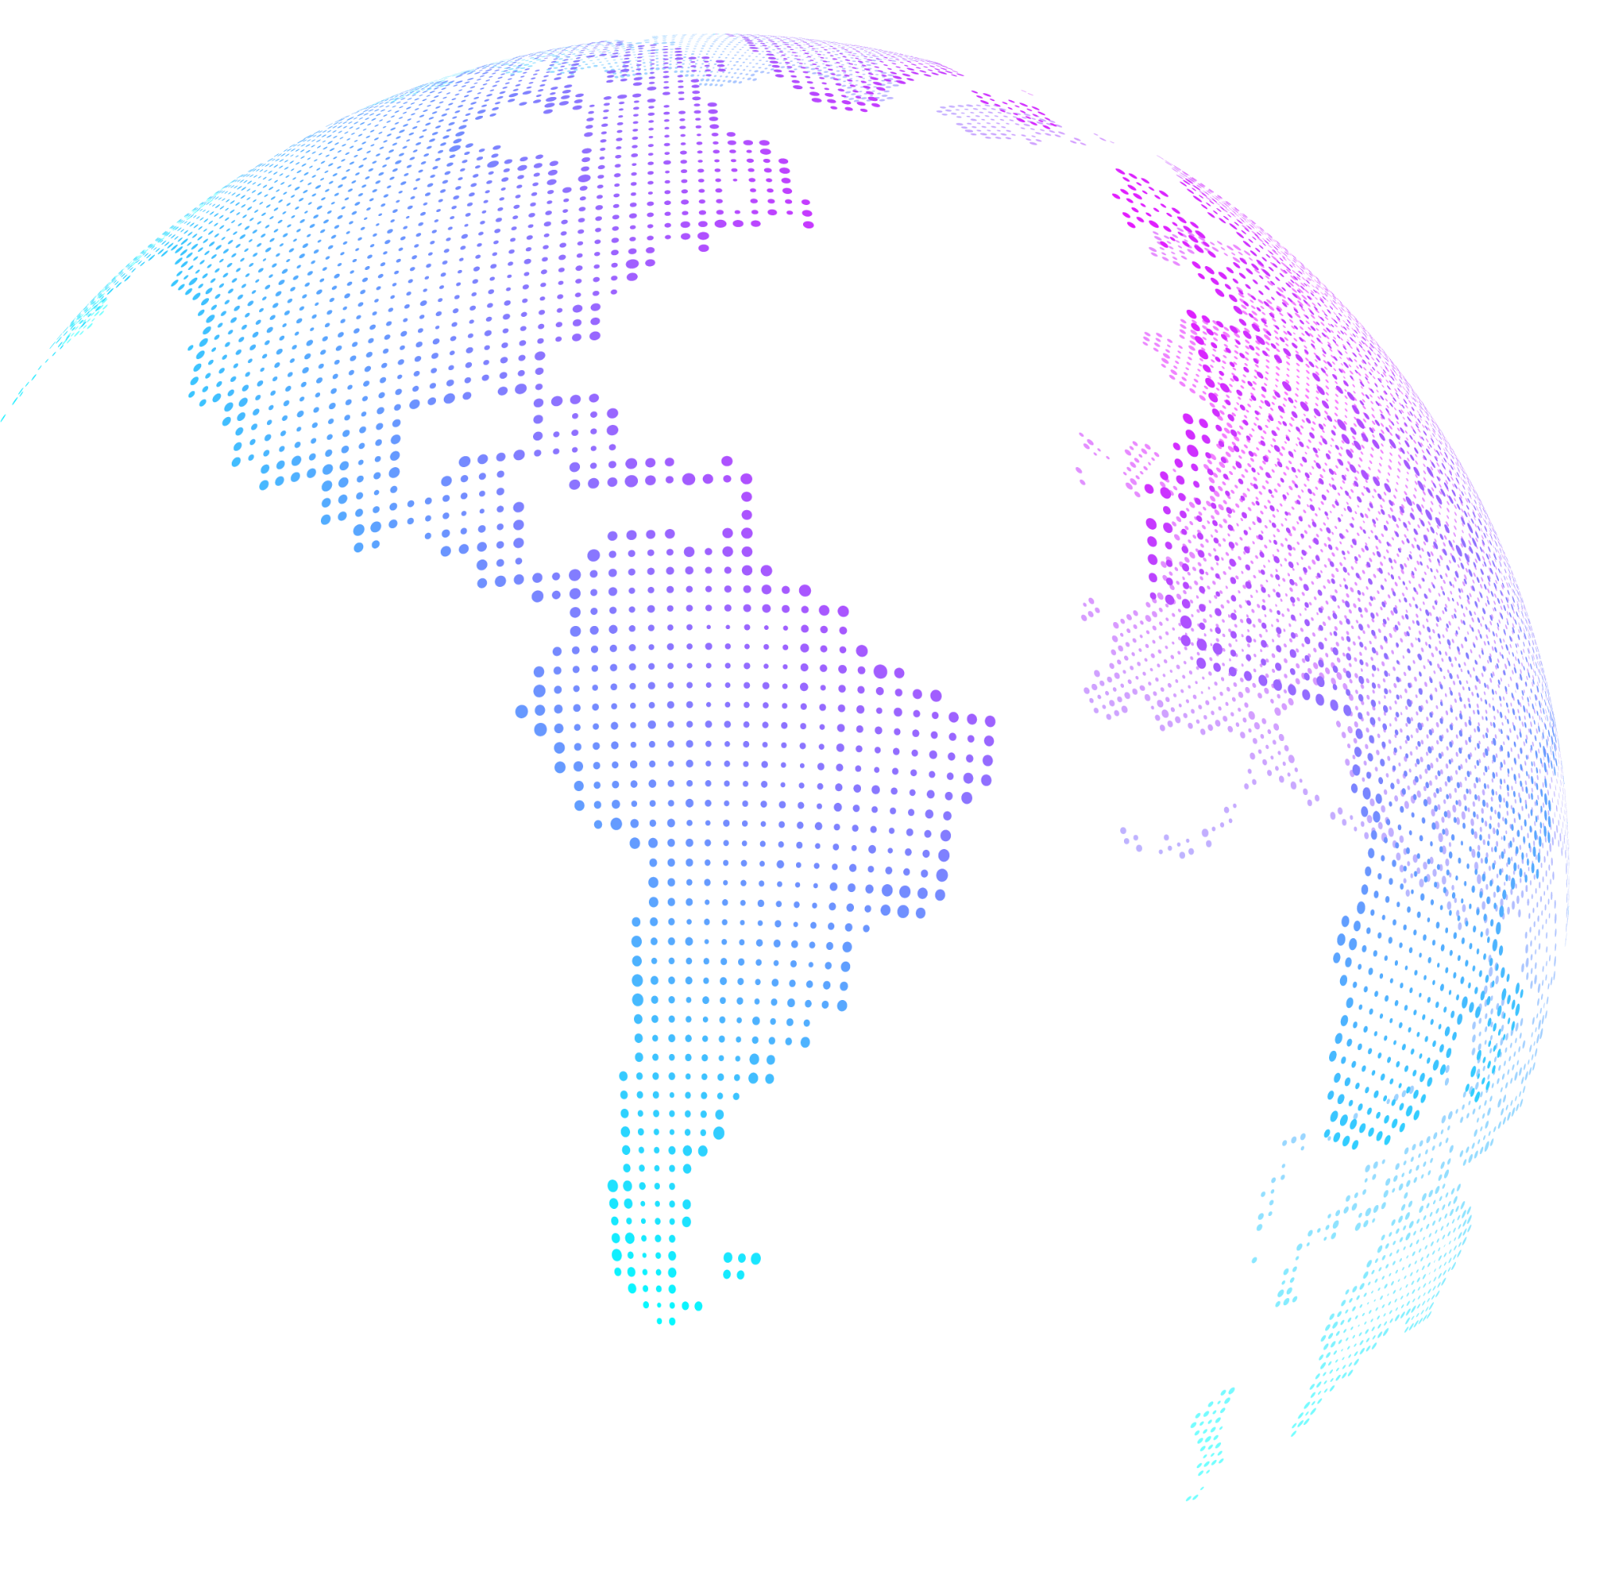

Slide 26
01
04
07
02
05
08
03
06
09

Slide 27
Icons Duotone → copy, paste, position, scale & recolor them in your awesome slides
Double click an icon to select and change the colors

Slide 28
Icons → to copy, paste, position, scale and recolor for your awesome slides
Double click an icon to select and change the colors

Slide 29
Icons Bold
Double click an icon to select and change the colors

Slide 30
Icons Light
Double click an icon to select and change the colors

Slide 31
Icons Solid
Double click an icon to select and change the colors

